Slide 1

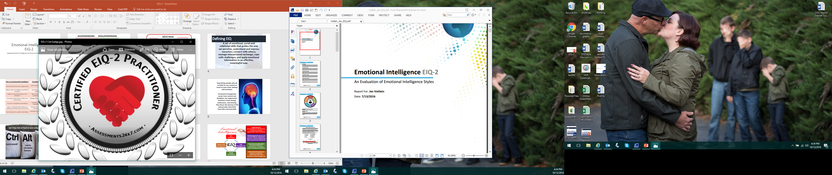
Emotional Intelligence EIQ-2
Applying Emotional Intelligence for Personal and Professional Success

Slide 2

Introductions
Please introduce yourself:
Name & Title
What do you know about EIQ already?
What are you hoping to gain from this session?

Slide 3
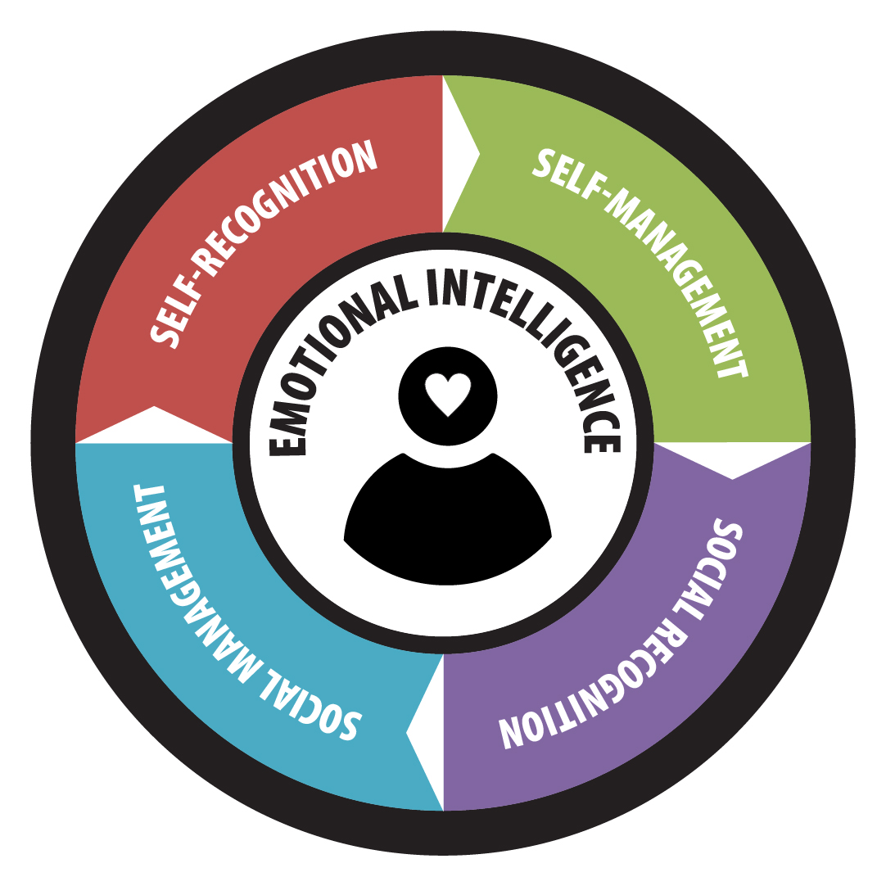
Emotional Intelligence
The ability to:
perceive emotions
access and generate emotions to assist thought
understand emotions and emotional knowledge
reflectively regulate emotions to promote emotional and intellectual growth
Emotional Intelligence is a way of recognizing, understanding and choosing how we think, feel and act, shaping our understanding of ourselves and our interactions with others.
Notes:
Emotional intelligence focuses on self and relationships. Intrapersonal awareness and management deal with recognizing, acknowledging and working with emotions. Interpersonal relationships deal with empathy, connection and social skills. These are known as soft skills but tend to be more meaningful in performance.

Slide 4
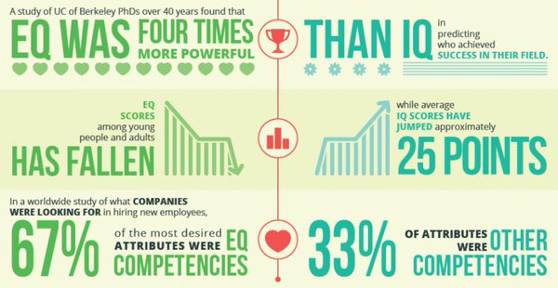
Why Does it Matter?
Notes:
Based on this information, EQ is an influential contributor to personal and professional success and yet there is a lack of support for learning and growth in this area.

Slide 5
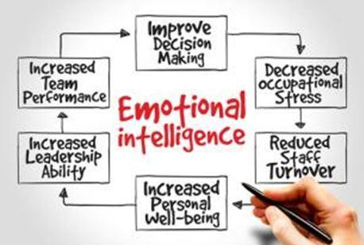
EIQ can be measured as difference directly associated with personal and professional success in many areas, including:
Communication
Decision-Making
Leadership
Sales
Teamwork & Team Performance
Productivity
Relationship Satisfaction
Customer Service
Conflict Management
Overall Effectiveness
Why Does it Matter?
Notes:
Furthermore, there are so many benefits to having a strong EIQ.

Slide 6
Low Emotional Intelligence | High Emotional Intelligence
Feels misunderstood and unappreciated | Learns and adapts to audiences and situations
Blames others for problems and difficult situations | Assumes responsibility and fixes problems (creatively)
Subject to emotional outbursts and moodiness | Takes control of performance and productivity; Self-disciplined
Gets angry and hostile in conflict and confrontation | Manages feelings for positive, win/win resolution
Focuses on competition and winning | Emphasizes abundance thinking, teamwork and collaboration
Doesn’t understand what others are thinking and feeling unless directly told | Effective at reading both verbal and nonverbal cues for empathy
Has few long-term, quality relationships | Leverages relationships for mutual gain and growth
Notes:
High/Low Emotional Intelligence
Quick tips on high and low emotional intelligence.

Slide 7
Self Intra-Personal
Social Inter-Personal
Self Recognition
Self-confidence
Awareness of emotional state
Recognizing cause and effect in emotion
Paying attention to changes in emotional states
Social Recognition
Empathy
Picking up the moods of others
Caring what others are going through
Reading both verbal and nonverbal signals
Recognition
Self Management
Creating goals and direction
Discipline and self-control
Being trustworthy
Flexibility and adaptability
Optimism
Motivation and Initiative
Sustaining quality relationships
Handling conflict effectively
Leadership and influence
Collaboration, cooperation and teamwork
Effective interaction
Social Management
Management
Notes:
The Emotional Intelligence Index reviews four (4) basic areas. Within each competency, there is an overall score. The Index is predicated on the abilities to recognize, understand and manage emotions (intrapersonal communication); and the ability to recognize, empathize, and relate to others (interpersonal communication). The Emotional Intelligence Index evaluates several aspects of your emotional intelligence and suggests ways to improve it.

Slide 8
Optional Discussion
As a group:
What is the most important quotient measured in Emotional Intelligence and why?
Notes:
As the whole group to debate/discuss which of the 4 is most important?

Slide 9
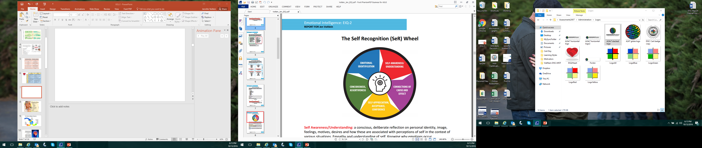
Self Recognition
Self Awareness/ Understanding
Connection of Cause and Effect
Self Appreciation, Acceptance and Confidence
Consciousness, Assertiveness
Emotional Identification
Self-recognition reflects intrapersonal communication. It is foundational to social awareness and self-management.
Notes:
Factors include: Personality style, learning style, mental attitude, comfort and discomfort, strengths and weaknesses, biofeedback, self-acceptance, self-esteem, temperament, tension and stress levels, spirituality and conscience.
Self Awareness/Understanding: a conscious, deliberate reflection on personal identity, image, feelings, motives, desires and how these are associated with perceptions of self in the context of various situations. Empathy and understanding of self. Knowing why emotions occur.
Connections of Cause and Effect: recognition of the impact and consequence of behaviors on feelings and moods; separating external and internal factors effecting emotions. Knowing how feelings relate to performance.
Self Appreciation, Acceptance and Confidence: development of self esteem; personal worth and value; and coming to grips with personal attributes. Recognizing personal strengths, weaknesses, and limitations. Operating with realistic self assurance.
Consciousness, Assertiveness: intentional establishment of personal boundaries and appropriate limits; choosing a path that expresses self worth through personal care and outward presentation
(presence).
Emotional Identification: ability to identify and name personal feelings; vocabulary and definition of emotions allowing choices, responses and performance; effective reflection on intrapersonal information.

Slide 10
Building Self-Recognition
Accept emotions without judgment.
Self monitor; take time to reflect and review.
Associate emotions with attitudes and consequences.
Accept advice without becoming defensive.
Develop greater mental security - feeling safe and comfortable with who you are regardless of outside challenges and threats.
Analyze strengths and weaknesses fairly and with an eye toward growth.
Create realistic personal expectations.
Cultivate positive mindset and optimism.
Connect with positive, supportive people.
Generate expectations of causes and consequences.

Slide 11
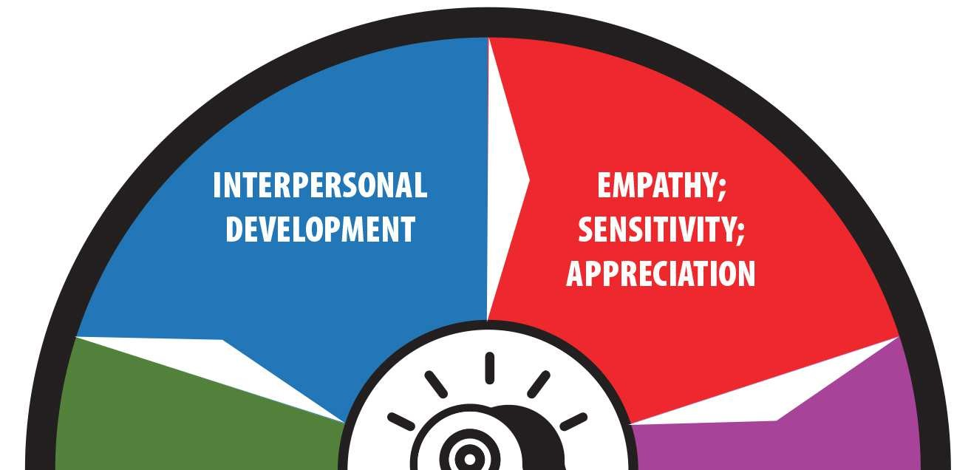
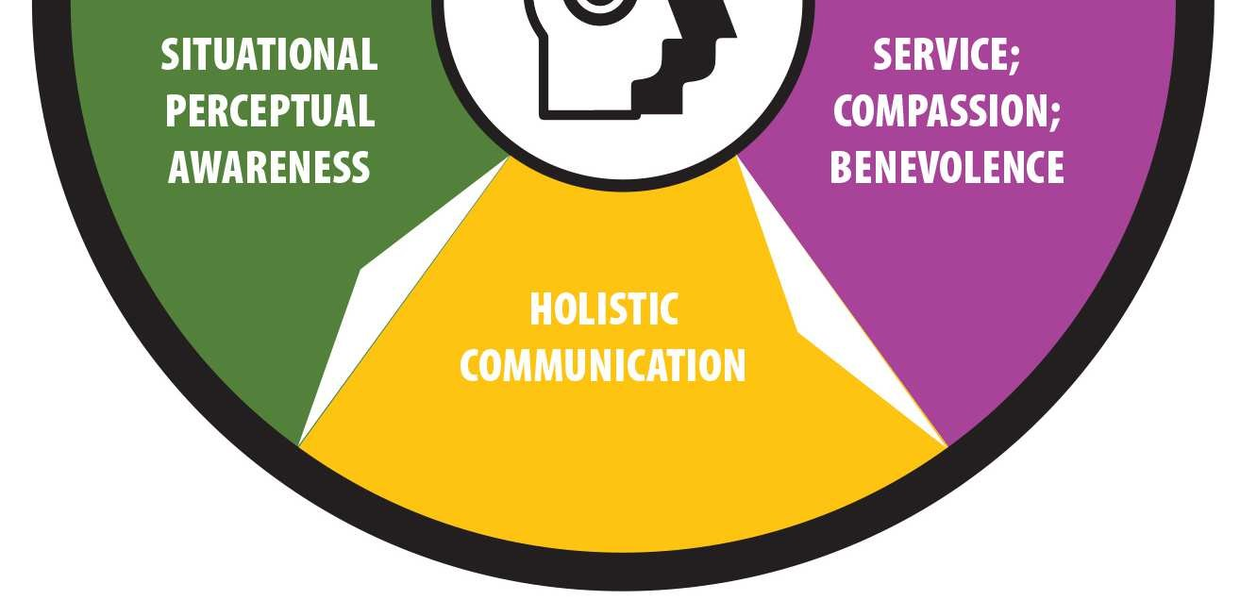
Social Recognition
Empathy, sensitivity, appreciation
Service, compassion, benevolence
Holistic Communication
Situational Perceptual Awareness
Interpersonal Development
Social-recognition reflects awareness and consideration of the feelings and responses of others. The ability to empathize and maintain sensitivity to the moods and emotions of others allows for superior connection.
Notes:
Factors included: Empathy, Understanding/compassion, Sensitivity/thoughtfulness, Appreciation, Holistic communication, Rapport, Connection and
Relationships
Empathy; Sensitivity; Appreciation: understanding others; accurately picking up emotional cues from communication (including words, tone and nonverbal signals); managing direct and indirect feedback effectively; being attentive, sensitive, aware and appreciative of the emotional signals of others.
Service; Compassion; Benevolence: operating with a sense of contribution; aiding, helping, coaching and developing others; giving; operating constructively to contribute to the emotional states and benefits of others; recognizing needs, wants and desires; relating to alternative thoughts, perceptions and perspectives.
Holistic Communication: the abilities to effectively send and receive information including emotional content; listening; engaging and connecting with others; sending and receiving verbal and nonverbal signals constructively.
Situational Perceptual Awareness: recognizing and processing dynamic, shifting emotional data; communicating attention, focus, awareness and connection; adapting to situational variables and changes; understanding which factors count, how much and responding with reasonable behavior.
Interpersonal Development: growing and nurturing constructive connections; setting the tone for long term depth and breadth in relationships; working with quality in personal and professional relations; having resonance and rapport.

Slide 12
Building Social-Recognition
Actively look for opportunities to help others and promote their agendas.
Actively listen; pay attention.
Take in feedback and critique from others.
Become more interested and enthusiastic about others.
Follow through on promises and commitments.
Create opportunities to connect.
Be positive and open when responding to new people and ideas.
Pay attention to both head and heart messages.

Slide 13
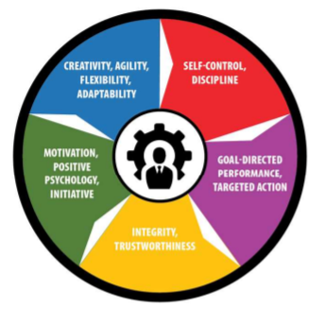
Self Management
Self-control, discipline
Goal-directed performance, targeted action
Integrity, trustworthiness
Motivation, positive psychology, initiative
Creativity, agility, flexibility, adaptability
Self-management measures self-evaluation coupled with self-regulation, to control and harness feelings that impact the ability to achieve personal objectives.
Notes:
Factors include: Restraint, Discipline, Control, Resolve, Direction/purpose, Emotional management, Flexibility, Enthusiasm/excitement
Satisfaction, happiness and contentment are results of self management.
Self Control; Discipline: effectively handling impulses; maintaining composure while experiencing stressful, trying emotions; managing preparation and performance; actively choosing paths; self directing; the ability to emotionally persist to achieve strategic objectives.
Goal Directed Performance; Targeted Action: focus to achieve long term desired goals; emotional tenacity and persistence; drive to choose challenging objectives and assume acceptable risk; staying the course to completion; resilience in the face of obstacles and setbacks; seizing opportunities.
Integrity; Trustworthiness: the ability to work with conscience, ethics and integrity; operating with personal standards, principles and values; being dependable, reliable and authentic; keeping promises and assuming personal responsibility.
Motivation, Positive Psychology; Initiative: self energizing; the ability to be mentally and emotionally engaged; attitude; passion; choosing cause and effect feelings; being responsible for personal success; acting and choosing feelings in accordance with positive emotions, optimism and constructive feelings; limiting negative emotions, patterns and spirals.
Creativity, Agility, Flexibility; Adaptability: coping with change, transition and development; adjusting to situations, relationships and feelings; handling curiosity and imagination to create, discover and explore opportunities; innovation for progress; cognitive and emotional shifts to augment and manage change; the abilities to problem solve and 'think outside the box.'

Slide 14
Building Self-Management
Set and monitor a specific course and path for each day.
Act with focus and intensity.
Define a clear path to desired goals.
Exercise discipline and self control in both short and long term projects.
Take time to evaluate and critique personal performance.
Identify gaps in desired returns and improve plans to achieve better results.
Avoid fatigue and burnout.
Stick with a concrete, articulated agenda.
Remain accountable for your actions.

Slide 15
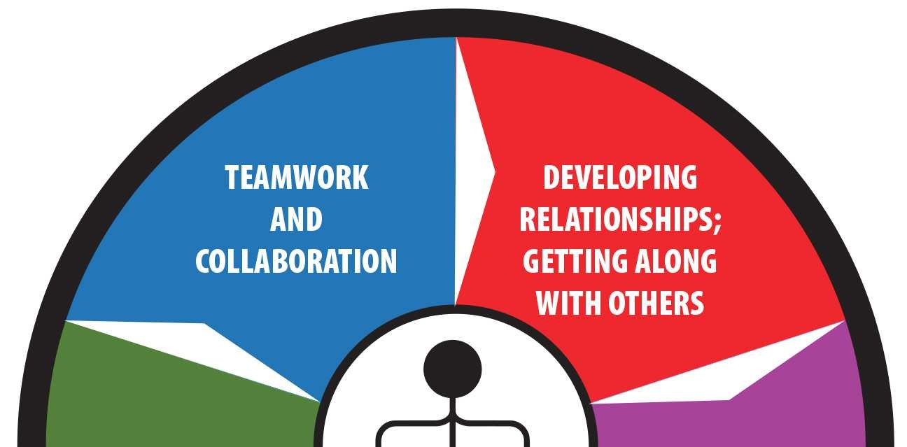
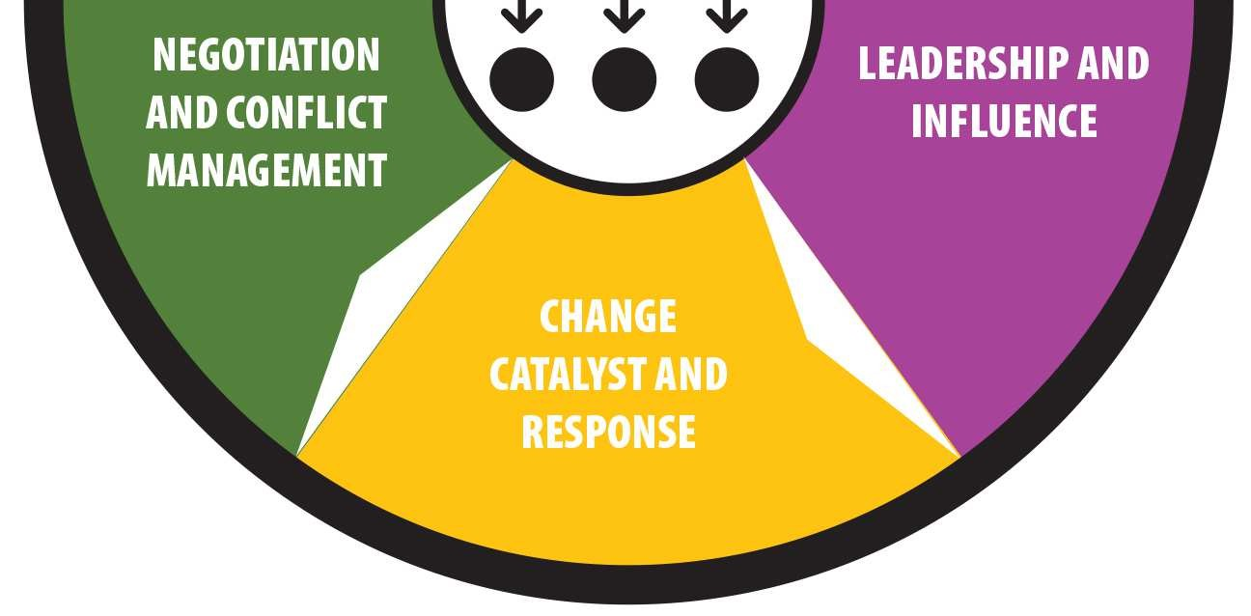
Social Management
Developing relationships, getting along with others
Leadership and influence
Change catalyst and response
Negotiation and conflict management
Teamwork and collaboration
Social (relationship) management includes interpersonal skills and focuses on generating results. Social EIQ fosters collaboration and connection.
Notes:
Factors include: Directing, Encouragement, Building friendships, Supporting, Social poise, Warmth, Team results, Collaboration
Developing Relationships; Getting Along with Others: cultivating, nurturing and maintaining long term personal and professional relationships; having quality connections and friendships.
Leadership and Influence: operating with warmth, likability, presence, charisma, and approachability; paying attention and focusing on results; being involved, engaging, passionate and powerful; showing deliberate persuasion; delivering solutions and success to others and to groups; partnering for targeted outcomes.
Change Catalyst and Response: recognizing the need for change and championing action; develop interpersonal skills and abilities; initiating growth and progress on individual, team and organizational levels; facilitating maturity and success. Focusing on eustress and positive outcomes.
Negotiation and Conflict Management: bargains with abundance thinking for mutual gains; copes with conflict through positive proactive and reactive techniques; effectively deals with difficult people and situations; creates unity, balance and gain.
Teamwork and Collaboration: builds bonds; transforms groups into teams; fosters unified, engaged effort; generates collaboration, cooperation, participation and high quality results; nurtures spirit de corps and the ability to develop synergy. Interpersonal emotional effectiveness.

Slide 16
Building Social-Management
Take an active interest in others and their agendas.
Develop persuasion and rapport.
Be assertive, engaged, enthusiastic and involved with others.
Maintain poise and calmness.
Look for positive, constructive answers that help everyone improve.
Seek out opportunities to work and collaborate with others.
Reach out and be available to others.
Enjoy listening to the ambitions of others and offer praise.
Develop quality relationships and friendships.

Slide 17

Emotional Intelligence
Application
Ask the Right Questions
Manage Emotions
Emotional Self-Coaching
Notes:
What are some things we can do to strengthen our emotional intelligence?

Slide 18
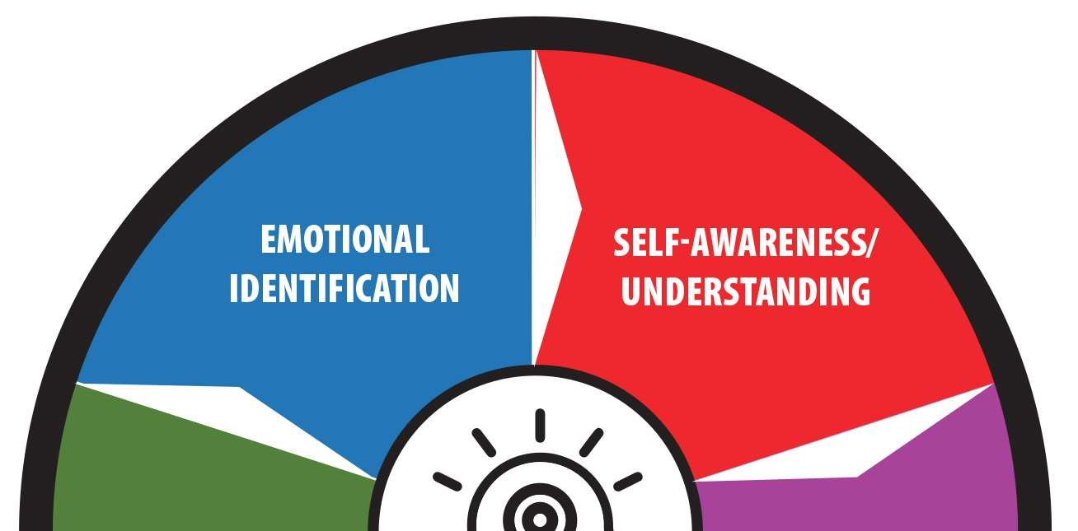
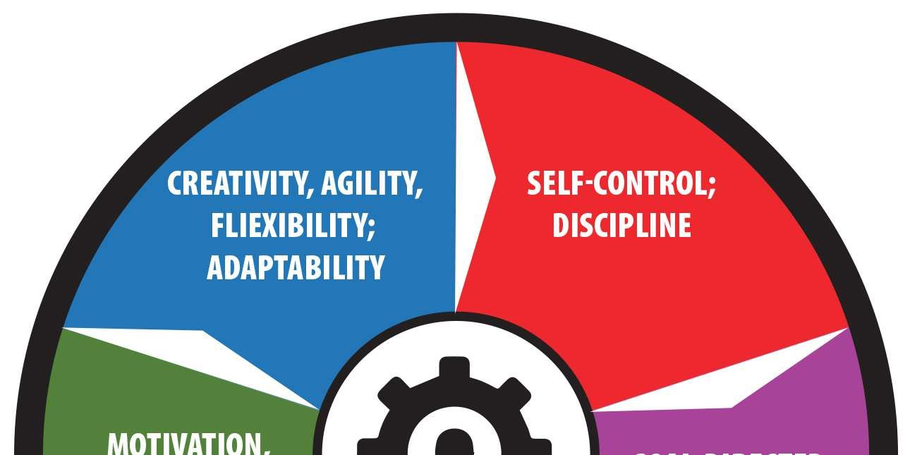
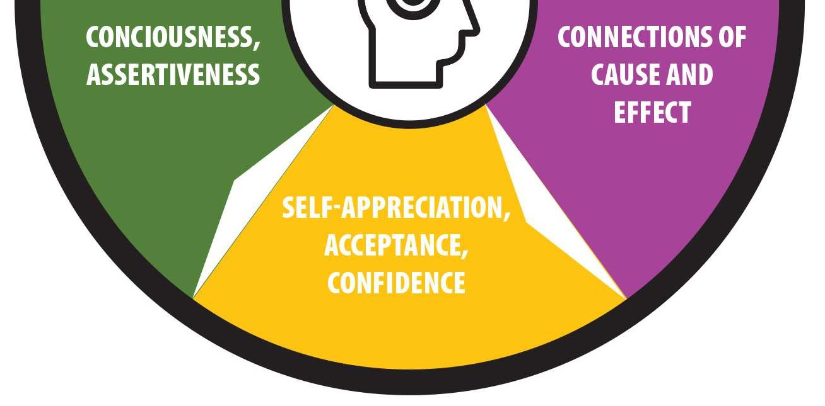
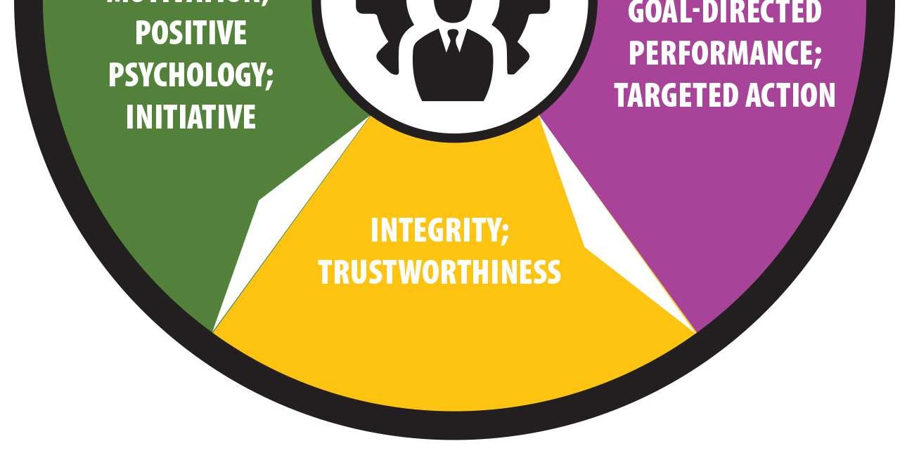
Optional Activity: Ask the Right Questions
Self Recognition
Who am I?
Social Recognition
Self Management
What are my priorities and goals?
How can I best manage my time, talent and resources?
Social Management
What is my purpose?
Where do I get my confidence, self-esteem, self-worth?
What makes me happy?
What can I do to serve and bring value?
What messages am I sharing (verbal/non-verbal)?
What are my key conversations (with whom, regarding what)?
How can I improve myself, my abilities, my value?
How can I promote abundance and mutual gain?
What can I do to add quality and strengthen relationships?
How can I share compassion, kindness, caring and consideration?
Notes:
Can be done as discussion or individually as reflection

Slide 19
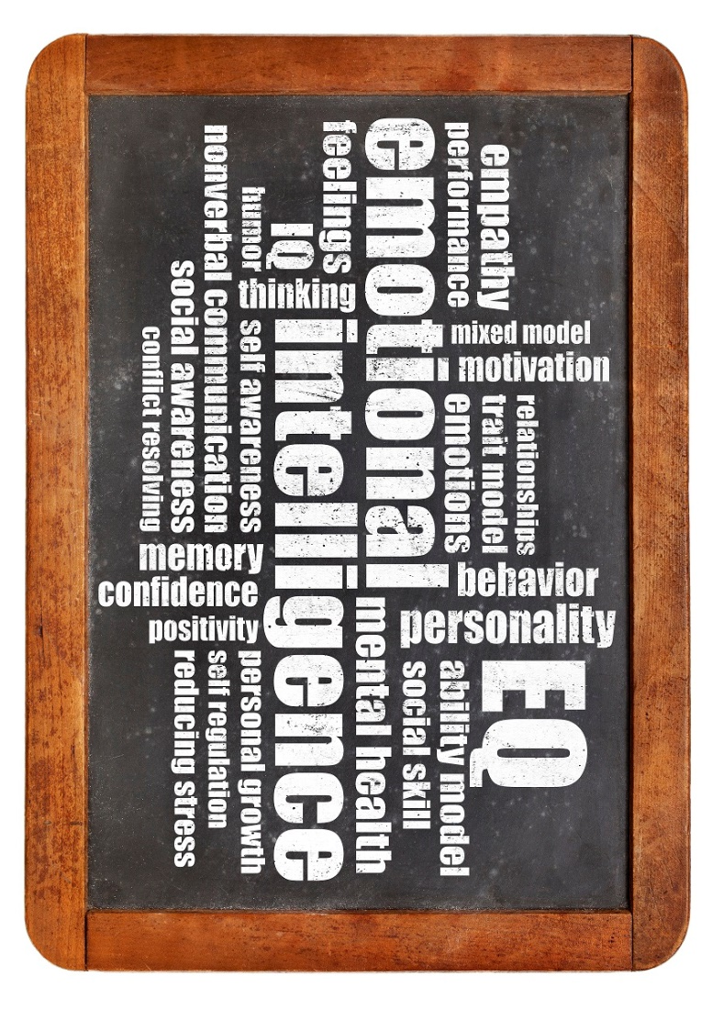
Managing Emotions
Become aware of:
Thoughts
Emotions
Behavior
Note the triggers
Project likely consequences & impacts
Relax
Manage/Cope/Adjust
Notes:
Become Self-Aware and Manage Emotions
Managing feelings comes through awareness , noting cause and effect, and taking appropriate action to respond rather than react.

Slide 20
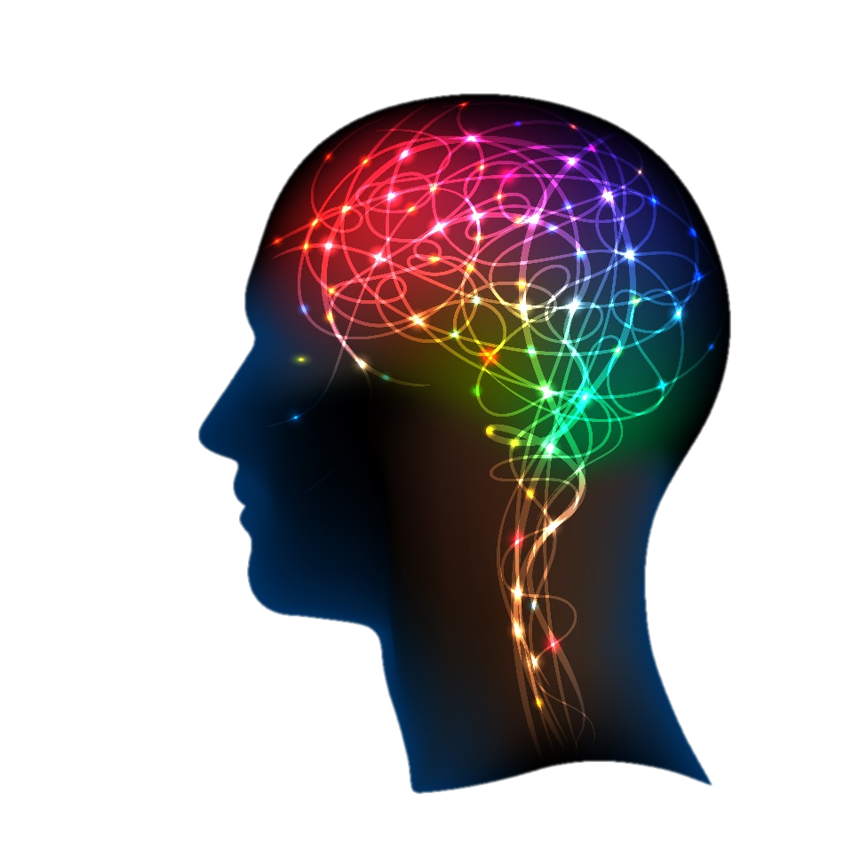
Observe
Pause
Direct
Action
Reflect
Celebrate
Perceive
Emotional Intelligence
Self-Coaching
Notes:
Self-Coach
Improvement happens when deliberate coaching and mentoring impact performance and results. Self-coaching begins by choosing areas to monitor and improve. Observation provides continual feedback. Perceptions allow for information to be processed and form improvement. A considered pause allows thought to catch up. Directing action and change comes from intentional focus. Reflection evaluates and analyzes. Celebration reinforces, conditions and shapes growth.

Slide 21
Emotional Intelligence EIQ-2
An Evaluation of Emotional Intelligence Styles Report Debrief

Slide 22
Remember
Building emotional intelligence takes practice!
Take it one day at a time, and focus on small changes that you can sustain to strengthen your EIQ.
You will see changes, though they may be gradual. Stick with it, and know that your learning and practice is a continual growth process.
Notes:
Building emotional intelligence takes practice. Competence breeds confidence, which leads to inner motivation.
The key to making EQ easier to master is to break the improvement suggestions into simple bite-size pieces that can be readily digested and successfully implemented in your life.
The speed with which you apply your new EQ knowledge should change your behaviors gradually, not radically, so that it affects your life permanently - not as quick fixes learned today, forgotten tomorrow. Training, learning and practicing must become an all the time behavior.

